Slide 1

Chapter 24
Congestion Control and
Quality of Service
24.<number>
Copyright © The McGraw-Hill Companies, Inc. Permission required for reproduction or display.

Slide 2
24-1 DATA TRAFFIC
The main focus of congestion control and quality of service is data traffic. In congestion control we try to avoid traffic congestion. In quality of service, we try to create an appropriate environment for the traffic. So, before talking about congestion control and quality of service, we discuss the data traffic itself.
Topics discussed in this section:
Traffic Descriptor
Traffic Profiles
24.<number>

Slide 3

Figure 24.1 Traffic descriptors
24.<number>

Slide 4
Traffic descriptors
Average data rate (ADR)
  It actually indicates the average bandwidth needed by the traffic.
  Average data rate= amount of data/time
Peak data rate (PDR)
  Defines the maximum data rate of the traffic. It actually indicates the maximum bandwidth that the networks need for the traffic to pass through.
Maximum burst size (MBS)
  Normally refers to the maximum length of time the traffic is generated at the peak rate.
Effective bandwidth
  Is the bandwidth that the network needs to allocate for the flow of traffic. It is a function f above three values.
24.<number>

Slide 5
Traffic Profiles
Constant bit rate
  Traffic model has a data rate that does not change.
  So ADR and PDR are the same.
  MBS is not applicable.
Variable bit rate
  The rate of the data flow changes in time with changes smooth instead of sudden and sharp.
  ADR and PDR are different.
  MBS is usually a small value.
Bursty
  The data rate changes suddenly in a very short time.
  ADR and PDR are very different values.
  MBS is significant.
  It is one of the main causes of congestion in a network.
24.<number>

Slide 6

Figure 24.2 Three traffic profiles
24.<number>

Slide 7
24-2 CONGESTION
Congestion in a network may occur if the load on the network—the number of packets sent to the network—is greater than the capacity of the network—the number of packets a network can handle. Congestion control refers to the mechanisms and techniques to control the congestion and keep the load below the capacity.
24.<number>

Slide 8
24-3 CONGESTION CONTROL
Congestion control refers to techniques and mechanisms that can either prevent congestion, before it happens, or remove congestion, after it has happened. In general, we can divide congestion control mechanisms into two broad categories: open-loop congestion control (prevention) and closed-loop congestion control (removal).
Topics discussed in this section:
Open-Loop Congestion Control
Closed-Loop Congestion Control
24.<number>

Slide 9

Figure 24.5 Congestion control categories
24.<number>

Slide 10
Open-loop congestion control uses to prevent congestion
Retransmission Policy
  If packet is lost or corrupted, retransmit.
  It may increase congestion in the network.
  Good retransmission policy can prevent congestion.
Window Policy
  Type of sender side window may affect congestion.
  The SR is better than GBN.
Acknowledgement Policy
  The ACK policy imposed by the receiver may effect congestion.
  Sending fewer ACKs means imposing less load on the network.
Discarding Policy
  A good discarding policy as less sensitive data packets in an audio transmission may be discarded to avoid congestion.
Admission Policy
  If there is a congestion in a network then router can deny to establish new virtual connections.
24.<number>

Slide 11
Closed Loop congestion Control
Back Pressure
  It is mechanism in which a congested node stops receiving data from the immediate upstream node. And this will continue for all nodes.
  Back Pressure is a node to node congestion control that starts with a node and propagates.
  Can only be applied to virtual circuit networks in which each node knows about its upstream nodes.
24.<number>

Slide 12

Figure 24.6 Backpressure method for alleviating congestion
24.<number>

Slide 13
Closed Loop congestion Control
Choke Packet
  Is a packet sent by a node to the source to inform it of congestion.
  Difference in back pressure and choke point.
  Example is ICMP messages.
Implicit Signaling
  There is no communication between the congested node and the source.
  The source guesses that there is a congestion somewhere in the network from other symptoms.
  As an example, when a source sends several packets and there in no ACK, assumption is that network is congested. The source should slow down.
24.<number>

Slide 14

Figure 24.7 Choke packet
24.<number>

Slide 15
Closed Loop congestion Control
Explicit Signaling
  The node that is experiencing congestion can explicitly send the signal to source or destination.
  In choke point method, a separate packet is used for this purpose; however in explicit signaling method, the signal is included in the packets that carry data.
  Backward signaling
    A bit can be set in a packet moving in the direction opposite to the congestion. This bit can warn the source for congestion.
  Forward signaling
    A bit can be set in a packet moving in the direction to the congestion. This bit can warn the destination for congestion.
24.<number>

Slide 16
24-4 TWO EXAMPLES
To better understand the concept of congestion control, let us give two examples: one in TCP and the other in Frame Relay.
Topics discussed in this section:
Congestion Control in TCP
Congestion Control in Frame Relay
24.<number>

Slide 17
Congestion control in TCP
Congestion window
Congestion Policy
  It actually based on three phases.
    Slow start
    Congestion avoidance
    Congestion detection
24.<number>

Slide 18
Slow start: Exponential Increase
The important algorithm used in TCP is slow start.
This algo is based on the idea that the size of the cwnd starts with one maximum segment size (MSS).
Slow start cannot continue indefinitely.
A threshold is used to stop the phase.
The sender keeps track of a variable named ssthresh (slow start threshold).
When the size of the window in bytes reaches at threshold, slow starts stops and the next phase starts.
The value of the threshold is 65,535.
24.<number>

Slide 19

Figure 24.8 Slow start, exponential increase
24.<number>

Slide 20

Note
In the slow-start algorithm, the size of the congestion window increases exponentially until it reaches a threshold.
24.<number>

Slide 21
Congestion Avoidance
When the size of the congestion window reaches its ssthresh, the slow start phase stops and the congestion avoidance phase begins.
In this algorithm each time the whole window of segments is acknowledged, the size of the congestion window is increased by 1.
24.<number>

Slide 22

Figure 24.9 Congestion avoidance, additive increase
24.<number>

Slide 23
Note
In the congestion avoidance algorithm, the size of the congestion window increases additively until
congestion is detected.
24.<number>

Slide 24
Congestion Detection: Multiplicative decrease
If congestion occurs, the congestion window size must be decreased.
The only way the sender can guess that congestion occurred is by the need to retransmit a segment.
24.<number>

Slide 25
Note
An implementation reacts to congestion detection in one of the following ways:
❏ If detection is by time-out, a new slow
start phase starts.
❏ If detection is by three ACKs, a new
congestion avoidance phase starts.
24.<number>

Slide 26
Two Reactions
If a time out occurs, there is a stronger possibility of congestion.
  It sets the value of threshold to one-half of the current window size.
  It sets cwnd to the size of one segment.
  It starts the slow-start phase again.
If 3 ACKs are received, there is a weaker possibility of congestion.
  It sets the value of threshold to one-half of the current window size.
  It sets cwnd to the value of threshold.
  It starts the congestion avoidance phase again.
24.<number>

Slide 27

Figure 24.10 TCP congestion policy summary
24.<number>

Slide 28

Figure 24.11 Congestion example
24.<number>

Slide 29
24-5 QUALITY OF SERVICE
Quality of service (QoS) is an internetworking issue that has been discussed more than defined. We can informally define quality of service as something a flow seeks to attain.
Topics discussed in this section:
Flow Characteristics
Flow Classes
24.<number>

Slide 30

Figure 24.15 Flow characteristics
24.<number>

Slide 31
24-6 TECHNIQUES TO IMPROVE QoS
In Section 24.5 we tried to define QoS in terms of its characteristics. In this section, we discuss some techniques that can be used to improve the quality of service. We briefly discuss four common methods: scheduling, traffic shaping, admission control, and resource reservation.
Topics discussed in this section:
Scheduling
Traffic Shaping
Resource Reservation
Admission Control
24.<number>

Slide 32
Scheduling
A good scheduling technique treats the different flows in a fair and appropriate manner.
We would discuss the three scheduling techniques to improve the quality of service.
  FIFO Queuing
  Priority Queuing
  Weighted Fair Queuing
24.<number>

Slide 33

Figure 24.16 FIFO queue
24.<number>

Slide 34

Figure 24.17 Priority queuing
Starvation can occur here for the data in low priority queue.
24.<number>

Slide 35

Figure 24.18 Weighted fair queuing
24.<number>

Slide 36
Traffic Shaping
Traffic shaping is a mechanism to control the amount and the rate of the traffic sent to the network.
Two techniques will be discussed here
  Leaky Bucket
  Token Bucket
24.<number>

Slide 37

Figure 24.19 Leaky bucket
24.<number>

Slide 38

Figure 24.20 Leaky bucket implementation
24.<number>

Slide 39
Note
A leaky bucket algorithm shapes bursty traffic into fixed-rate traffic by averaging the data rate. It may drop the packets if the bucket is full.
24.<number>

Slide 40
Leaky bucket
If the traffic consists of variable-length packets, the fixed output rate must be based on the number of bytes or bits.
Algorithm for variable-length packets:
Initialize a counter to n at the tick of the clock.
If n is greater than the size of the packet, send the packet and decrement the counter by the packet size. Repeat this step until n is smaller than the packet size.
Reset the counter and go to step 1.
24.<number>

Slide 41
Note
The token bucket allows bursty traffic at a regulated maximum rate.
24.<number>

Slide 42
Token Bucket
Leaky bucket is very restrictive. It does not credit an idle host.
On the other hand, the token bucket algorithm allows idle hosts to accumulate credit for the future in the form of tokens.
For each tick of the clock, the system sends n tokens to the bucket. The system removes one token for every cell of data sent.
For example, if n is 100 and the host is idle for 100 ticks, the bucket collects 10,000 tokens. Now the host can consume all these tokens in one tick with 10,000 cells or the host takes 1000 ticks with 10 cells per tick.
24.<number>

Slide 43
Token Bucket
It can easily be implemented by a counter. The token is initialized to 0.
Each time a token is added, the token is incremented by 1.
Each time a unit of data is sent, the counter is decremented by 1.
When the counter is 0, the host cannot send data.
24.<number>

Slide 44

Figure 24.21 Token bucket
24.<number>

Slide 45
Resource reservation
A flow of data needs resources such as buffer, bandwidth, CPU time etc.
The QoS is improved if these resources are reserved beforehand.
24.<number>

Slide 46
Admission Control
It refers to the mechanism used by the router or switch to accept or reject a flow based on predefined parameters called flow specifications.
Before a router accepts a flow for processing, it checks the flow specifications.
24.<number>

Slide 47
24-7 INTEGRATED SERVICES
Two models have been designed to provide quality of service in the Internet: Integrated Services and Differentiated Services. We discuss the first model here.
Topics discussed in this section:
Signaling
Flow Specification
Admission
Service Classes
RSVP
Problems with Integrated Services
24.<number>

Slide 48
Note
Integrated Services is a flow-based QoS model designed for IP.
24.<number>

Slide 49
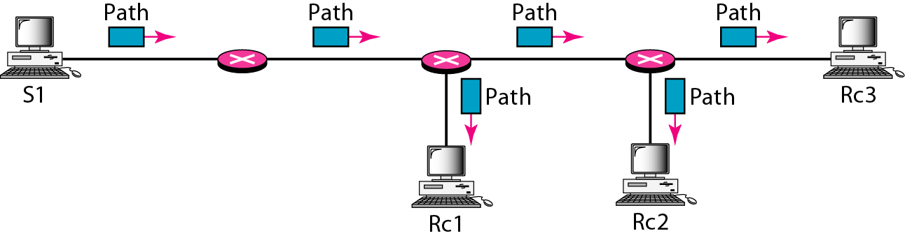
Figure 24.22 Path messages
24.<number>

Slide 50
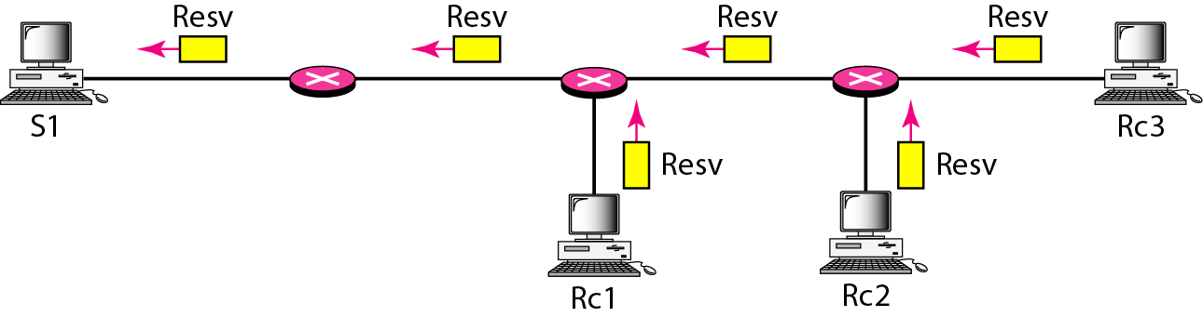
Figure 24.23 Resv messages
24.<number>

Slide 51
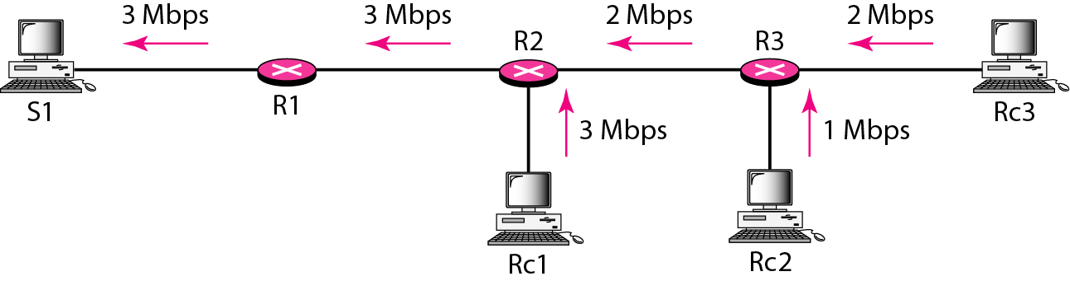
Figure 24.24 Reservation merging
24.<number>

Slide 52
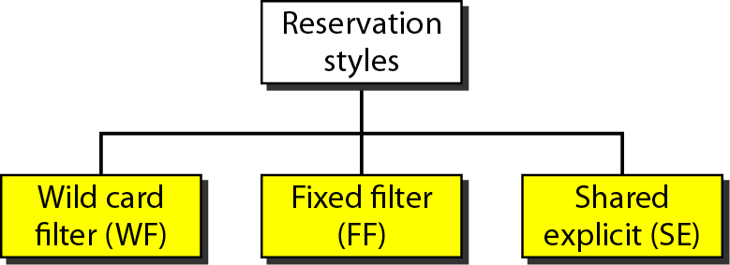
Figure 24.25 Reservation styles
24.<number>

Slide 53
24-8 DIFFERENTIATED SERVICES
Differentiated Services (DS or Diffserv) was introduced by the IETF (Internet Engineering Task Force) to handle the shortcomings of Integrated Services.
Topics discussed in this section:
DS Field
24.<number>

Slide 54
Note
Differentiated Services is a class-based QoS model designed for IP.
24.<number>

Slide 55

Figure 24.26 DS field
24.<number>

Slide 56
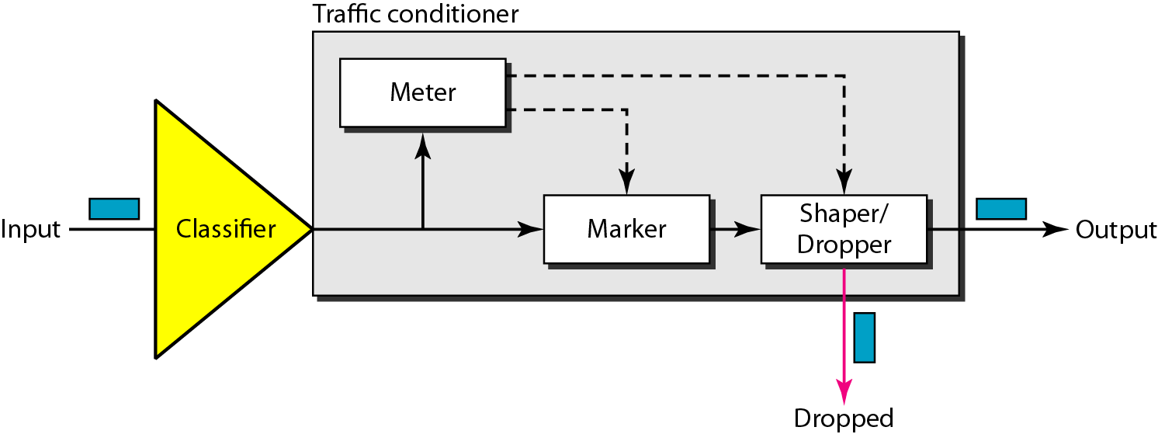
Figure 24.27 Traffic conditioner
24.<number>

Slide 57
24-9 QoS IN SWITCHED NETWORKS
Let us now discuss QoS as used in two switched networks: Frame Relay and ATM. These two networks are virtual-circuit networks that need a signaling protocol such as RSVP.
Topics discussed in this section:
QoS in Frame Relay
QoS in ATM
24.<number>

Slide 58
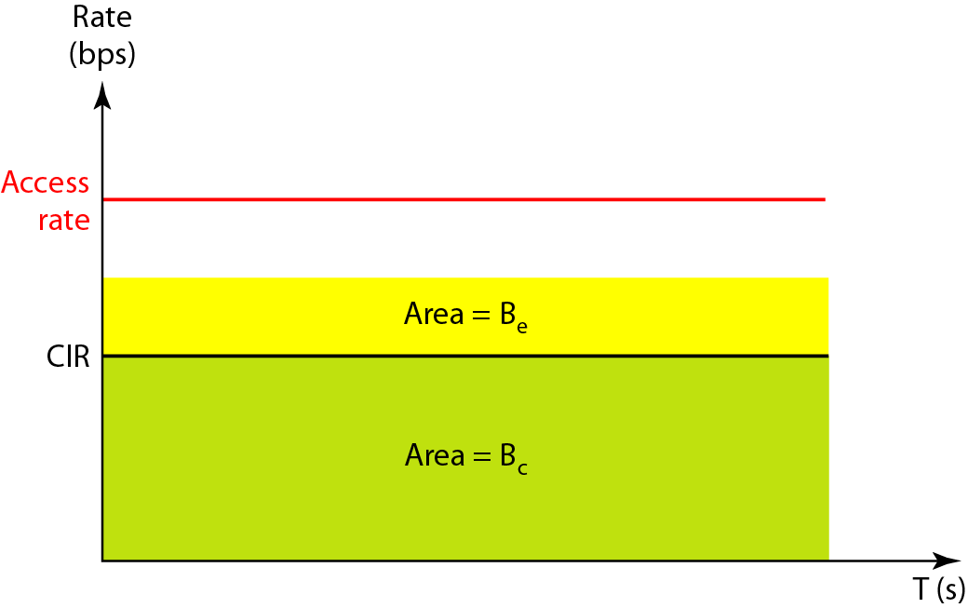
Figure 24.28 Relationship between traffic control attributes
24.<number>

Slide 59
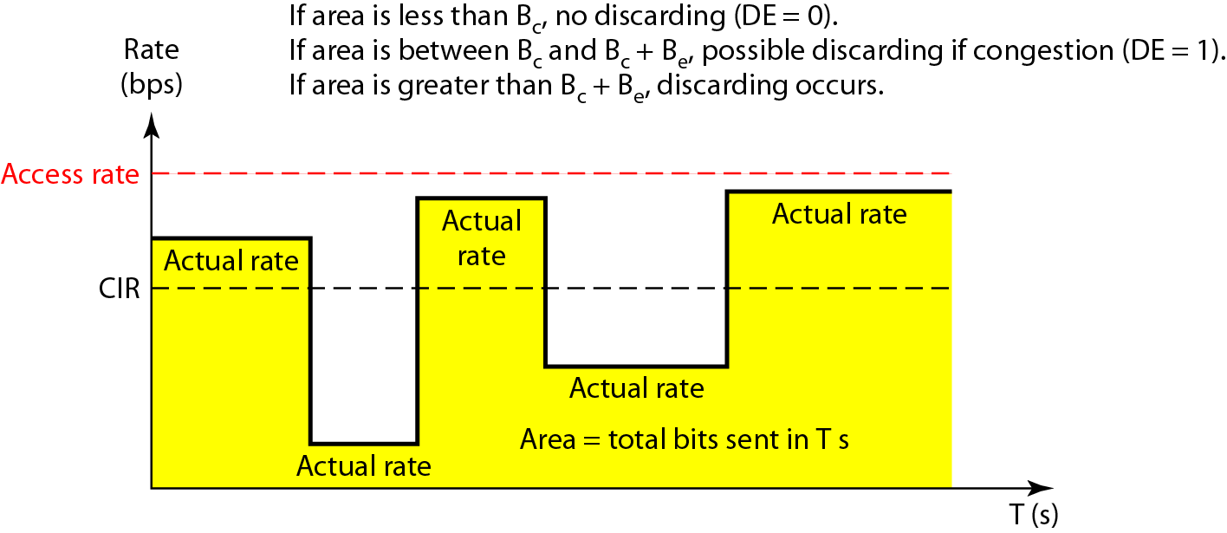
Figure 24.29 User rate in relation to Bc and Bc + Be
24.<number>

Slide 60
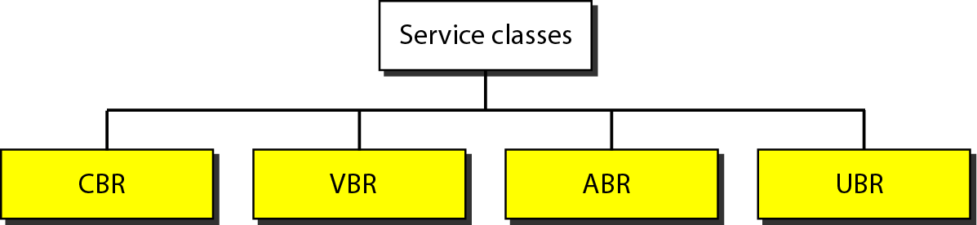
Figure 24.30 Service classes
24.<number>

Slide 61
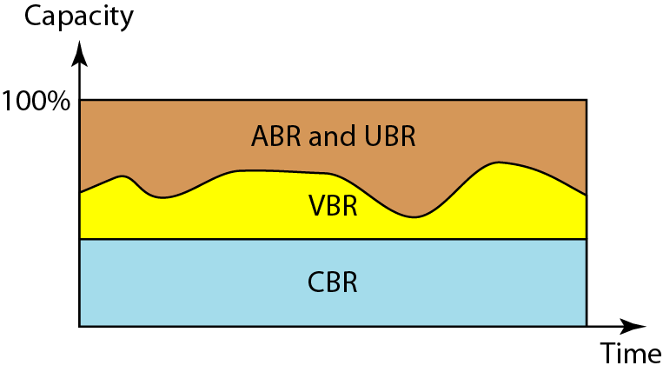
Figure 24.31 Relationship of service classes to the total capacity of the network
24.<number>

